Slide 1

Meeting Etiquette
Please be on Mute all the time.
Turn off Video, So that we can save bandwidth.
There is separate Q&A Section in End Please use that, Add questions in Google Form.
Break at 12PM for 15 min.
Mute your microphone
To help keep background noise to a minimum, make sure you mute your microphone when you are not speaking.
Be mindful of background noise
Avoid multitasking
All links and Slides will be shared.

Slide 2

Agenda
API Testing Interview Question and Answers
SOAP Testing with POSTMAN
Testing GraphQL API using POSTMAN
QnA

Slide 3
Common Test cases in API Testing
Security Testing - Non-functional testing like performance and security testing
Keys validation
Schema Validation - Data type, validations, order and completeness
HTTP Status Code
Response Verify
Accuracy of data

Slide 4
Which Tool You use to Test APIs
SoapUI
POSTMAN
Pact
Karate
Katalon Studio
Apigee

Slide 5
Why we do API Testing?
Cost Effective.
Test Core / Business Logic Layer Verification.
Low Maintenance Required
Language independent.

Slide 6
Testing Types in API?
Validation Testing
Functional Testing
UI testing
Load testing
Runtime/ Error Detection
Security testing
Penetration testing
Fuzz testing - Coding errors and security loopholes
Interoperability and WS Compliance testing

Slide 7
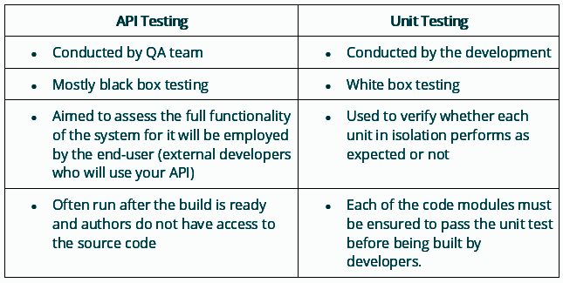
What are differences between API Testing and Unit Testing?

Slide 8
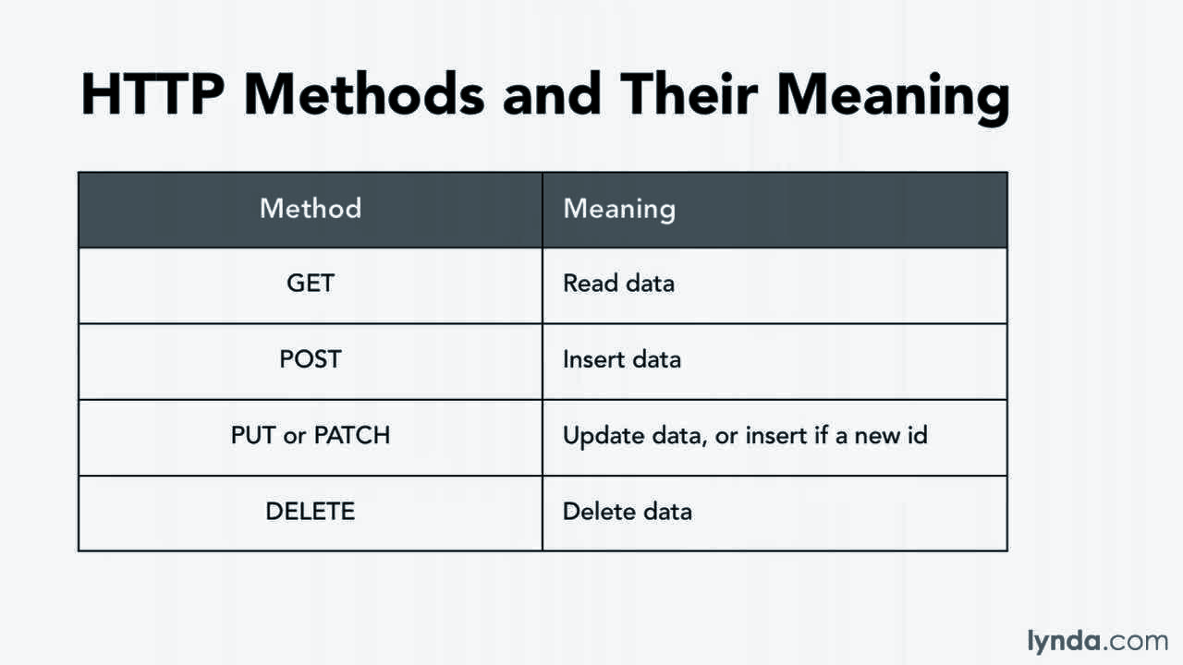
Different HTTP Methods

Slide 9
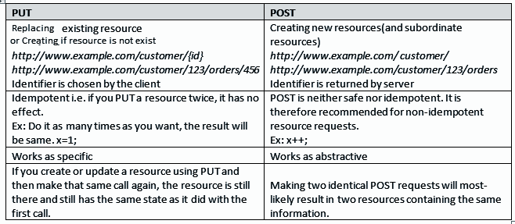
PUT VS POST

Slide 10
API Vs Web Service
All Web Services are API, But All APIs are not web services.
Web Services uses Three Styles, REST, XML-RPC, SOAP

Slide 11
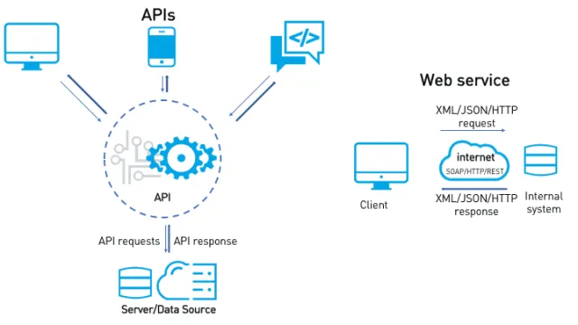
API Vs Web Service

Slide 12
HTTP Status Code 403
https://developer.mozilla.org/en-US/docs/Web/HTTP/Status/403
https://httpstatuses.com/

Slide 13
Path Param vs Query Param Https://abce.com/d/foo/?e=f

Slide 14
HTTP Status Code 201
https://developer.mozilla.org/en-US/docs/Web/HTTP/Status/201

Slide 15
Common Bugs in API?
Missing Keys
Duplicate Keys
Incorrect HTTP Code.
HTTP Methods not handled properly
Performance issues
Security issues
Validation errors
API Monitoring issues

Slide 16
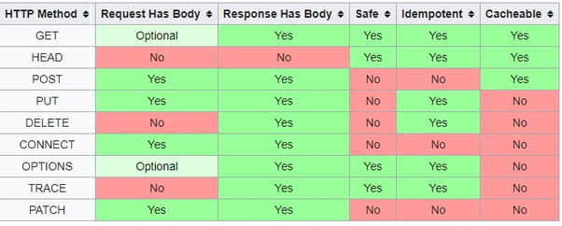
Idempotent And Safe

Slide 17
Example of SOAP Request
In POSTMAN.
var jsonObject = xml2Json(responseBody);
console.log(jsonObject["soap:Envelope"]["soap:Body"]["FahrenheitToCelsiusResponse"]["FahrenheitToCelsiusResult"])

Slide 18
Example of GraphQL
…..

Slide 19
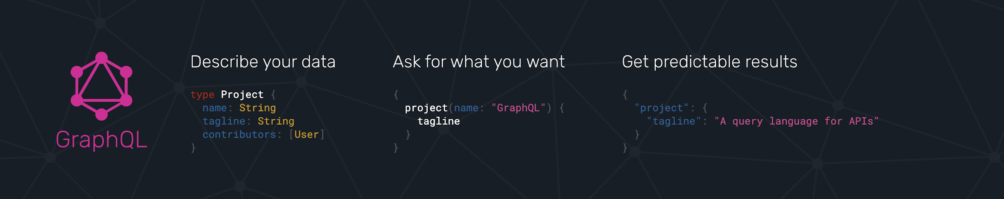
What is GraphQL?
Query Language of APIS.
Provides a Runtime Fulfilling those queries with your existing data.

Slide 20
What is GraphQL?
Client has the power to ask what he wants in response
Send a Query and get what you need no extra data.

Slide 21
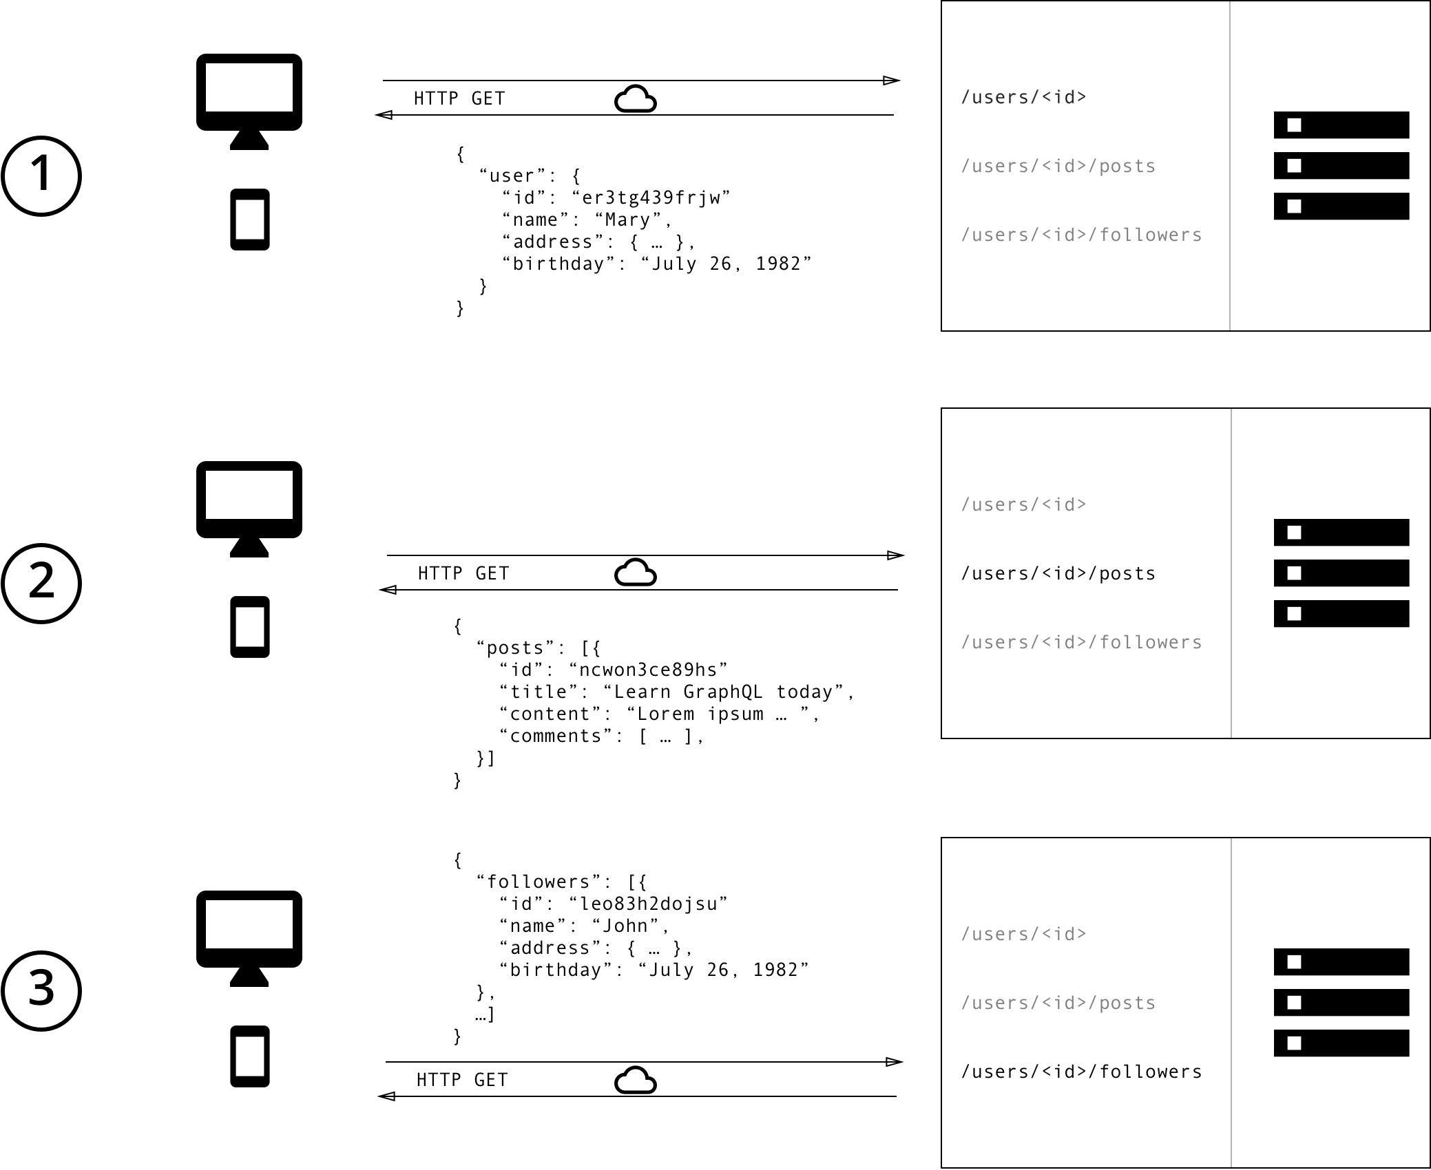

Slide 22
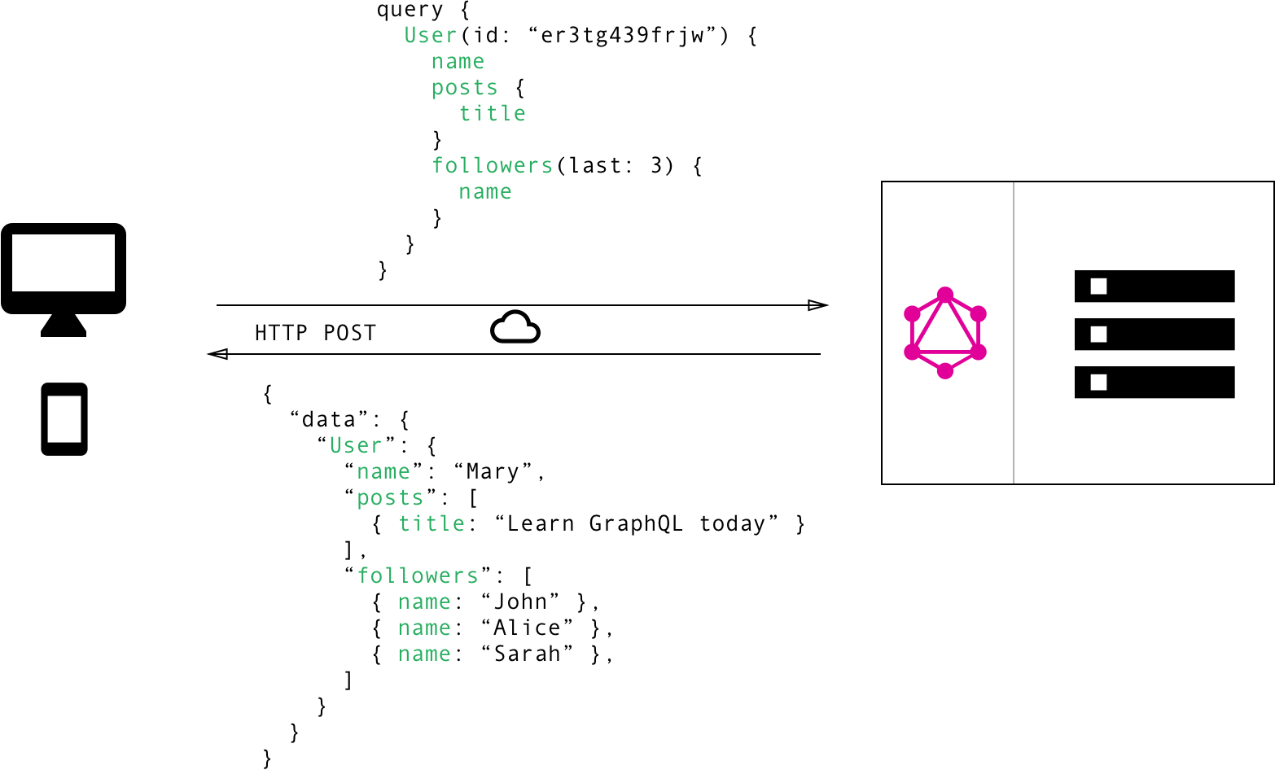

Slide 23
https://www.howtographql.com/basics/1-graphql-is-the-better-rest/

Slide 24

QnA
Go to link -
https://forms.gle/48eEPDsfxBNtDHRs5

